Slide 1
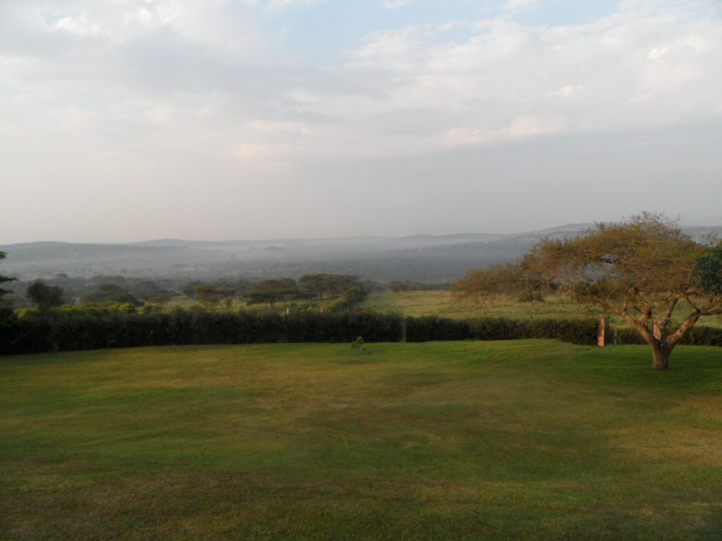
Key Definitions & Some Important Concepts
Larry Swatuk
Class 2 Part 2

Slide 2
Key Definitions
Nature refers to the totality of phenomena that are not created by humans, often understood as the non-human world governed by physical, biological, and ecological processes.
The natural world is the observable, material manifestation of nature—the ecosystems, species, landscapes, and physical processes that exist independently of human construction.
The biosphere is the global, integrated system of all living organisms and the zones of Earth that support life.
The environment refers to the surrounding conditions—natural, built, social, and institutional—that affect organisms or societies.

Slide 3
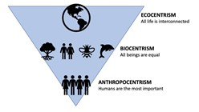
“Natural Resources”
Anthropocentric
Biocentric
Ecocentric

Slide 4
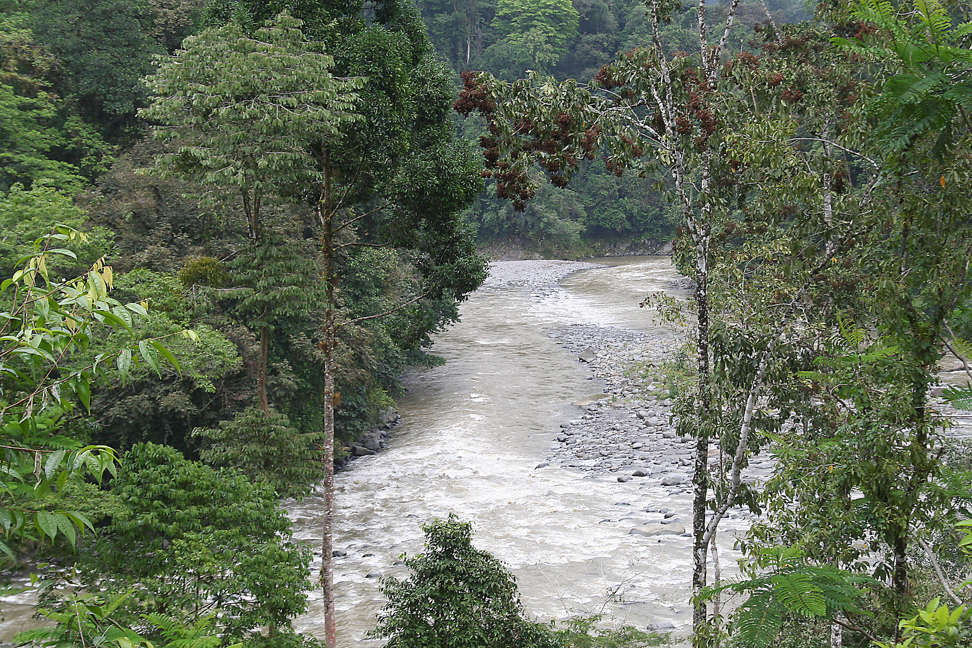
Different Perspectives
Ecocentric (system-centred value system)
Natural resources are interdependent components of ecological systems—living and non-living—that together sustain the integrity, resilience, and functioning of the Earth’s life-support systems, of which humans are a part.

Slide 5
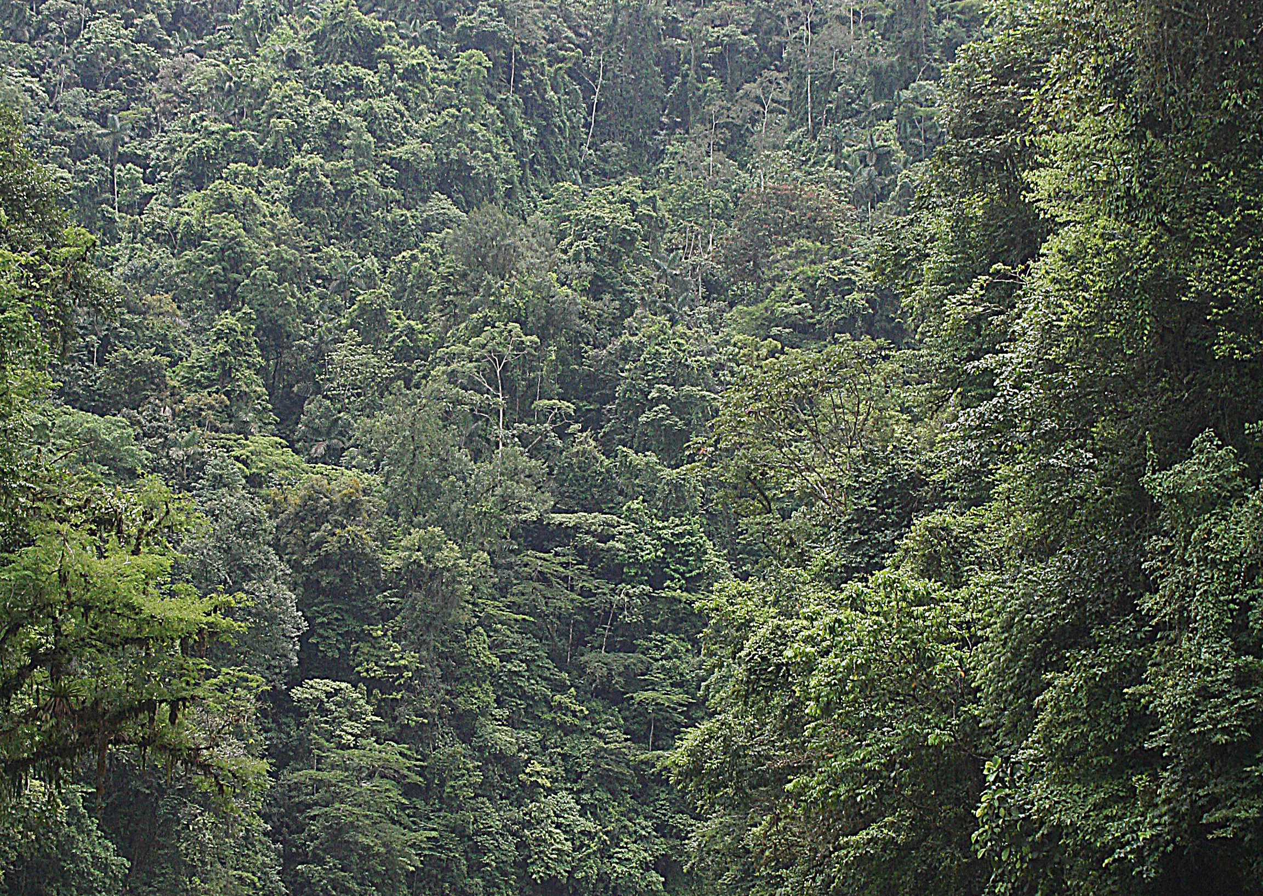
Different Perspectives
Biocentric (life-centred value system)
Natural resources are living organisms and ecological processes that sustain life, each possessing intrinsic value independent of human use, with humans regarded as one species among many.

Slide 6

Different Perspectives
Anthropocentic (human-centred value system)
Natural resources are components of the natural environment that humans value, appropriate, or manage for human needs and purposes, including economic production, livelihoods, security, and well-being.

Slide 7
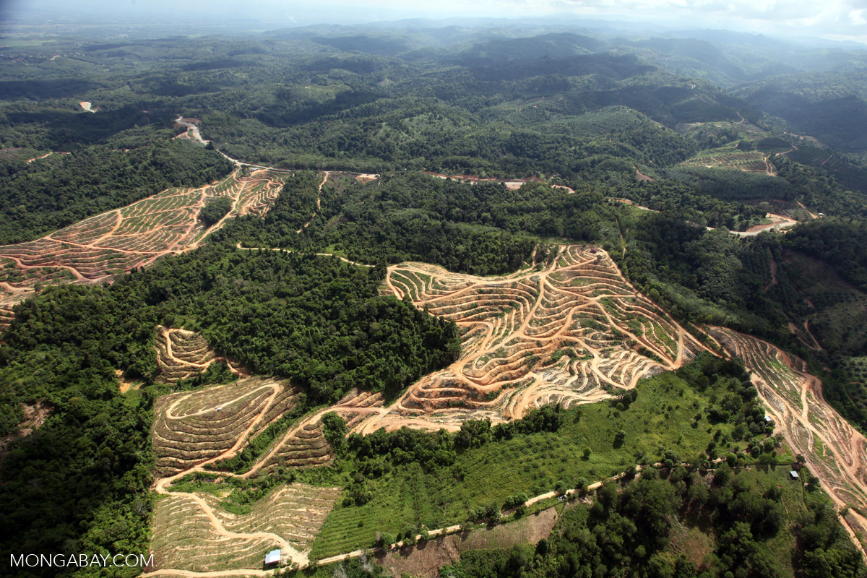
Crucial Insight for NRM
In real-world natural resource management, policies often blend these perspectives:
Anthropocentric logic dominates law, economics, and permitting
Biocentric values surface in species-at-risk and animal welfare
Ecocentric thinking underpins ecosystem-based management, watershed planning, and resilience frameworks

